Slide 1
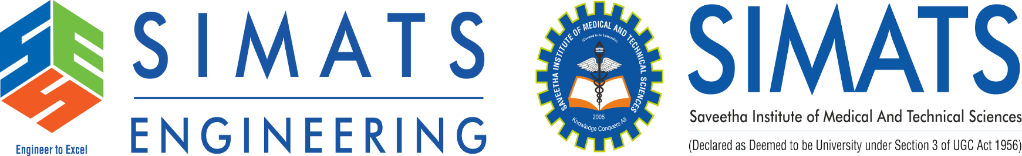
CSA5102 – CRYPTOGRAPHY AND NETWORK SECURITY
“Security Attacks, Threats, Risks and Their Impact on Security Goals”
Guided by
Dr. E. Anbalagan
Presented by
A. Midhuna(192521302)

Slide 2


Abstract
Threats and risks can cause data loss and system damage.
Attacks affect Confidentiality, Integrity, and Availability.
Proper security measures help reduce these risks.
Security attacks can seriously affect computer systems, networks, and sensitive data.

Slide 3
Introduction
Cybersecurity protects systems and data from attacks.
A threat is a possible danger to a system.
Risk is the chance of damage or loss.
CIA ensures data confidentiality, integrity, and availability.

Slide 4
Objective
To understand the effects of security threats on data and systems.
To identify suitable security measures to reduce cybersecurity risks.
To identify and understand different types of security attacks and threats.

Slide 5
Problem Statement
Increasing cyber attacks create serious threats to computer systems and data.
Weak security controls can allow unauthorized access to sensitive information.
Security attacks may cause data loss, modification, and system disruption.

Slide 6
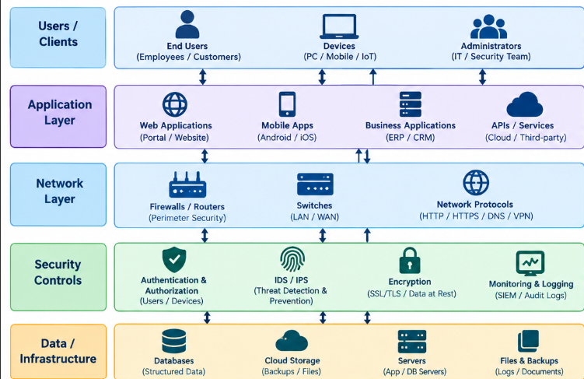
System Architecture

Slide 7
Future Scope
Future systems can use AI to detect security attacks and threats more effectively.
Advanced security tools can help identify risks before they cause serious damage.
Real-time monitoring can provide faster detection and response to cyber attacks.

Slide 8
Conclusion
Security attacks and threats can cause serious damage to systems and data.
Proper security measures can reduce cyber risks and protect sensitive information.
Strong cybersecurity practices help build a safe and reliable digital environment.

Slide 9
Thank You

